Slide 1
Selenium
Automated Testing Tool
Presenter name :-
md wahidul islam
Student ID: 20197 VA

Slide 2
Why automate testing?
Test automation has specific advantages for improving the long-term efficiency of a software team’s testing processes. Test automation supports:
Frequent regression testing
Rapid feedback to developers
Virtually unlimited iterations of test case execution
Support for Agile and extreme development methodologies
Disciplined documentation of test cases
Customized defect reporting
Finding defects missed by manual testing

Slide 3
Why Use/Learn Selenium
Increases your marketability
Has a lot of Java planks
Growing Industry standard
Assist with the deployment of defective-free code
Open source, web-based testing automation tool and cross-browser compliant
Muti-language backend support (Java, Ruby, Python, C#, PHP, etc.)

Slide 4
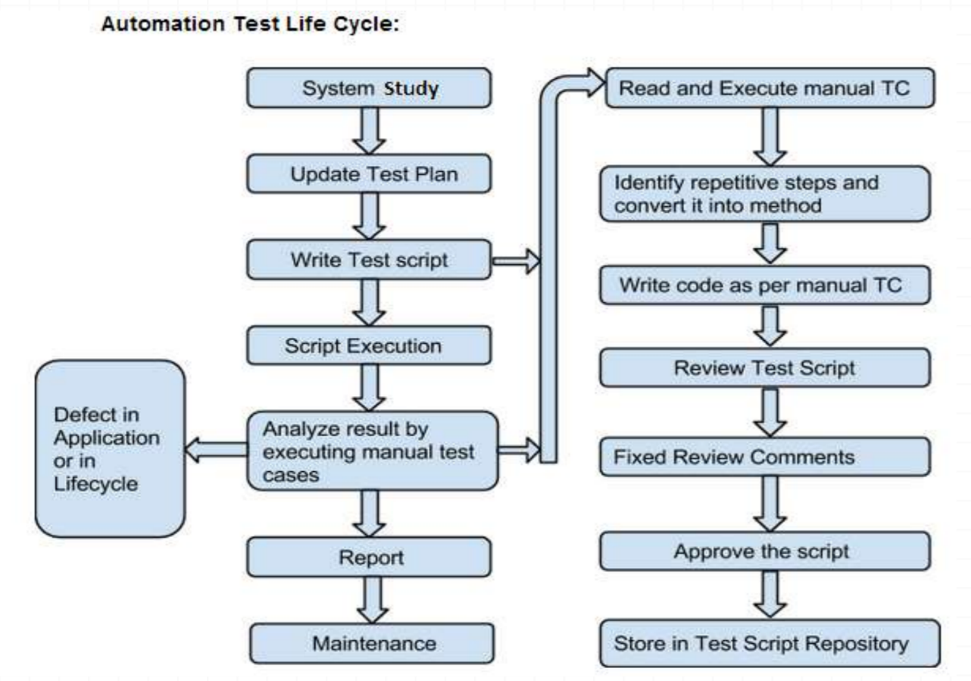
Automation Test Life Cycle

Slide 5
History
Developed in 2004 by Jason Huggins as a JavaScript library used to automate his manual testing routines
Selenium Core is born whose functionality underlies the Selenium RC (Remote Control) and Selenium IDE tools
The Limitation of having a JavaScript based automation engine and browser security restricted Selenium to specific functionality
Google, who has been a longtime user of Selenium, had a developer named Simon Stewart who developed WebDriver. This tool circumvented Selenium’s JavaScript sandbox to allow it to communicate with the Browser and Operating System directly using native methods
In 2008, Selenium and WebDriver merged technologies and intellectual intelligence to provide the best possible test automation framework

Slide 6
Introduction
Selenium is a suite of testing automation tools used for Web-Base applications: Selenium IDE, Selenium RC, Selenium WebDriver and Selenium Grid
These tools provide a rich set of testing functions specifically geared to varied testing scenarios of all types of Web applications
The operations provided by these tools are highly flexible and afford many options for comparing UI elements to expected application behavior
Selenium tests can be executed on multiple browser platforms

Slide 7
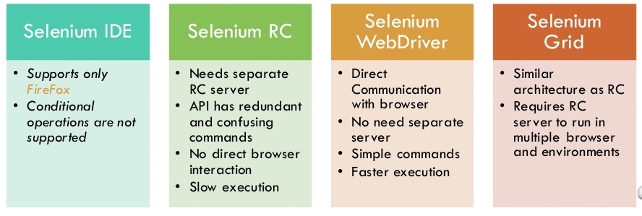
Selenium SUITE COMPONENTS

Slide 8
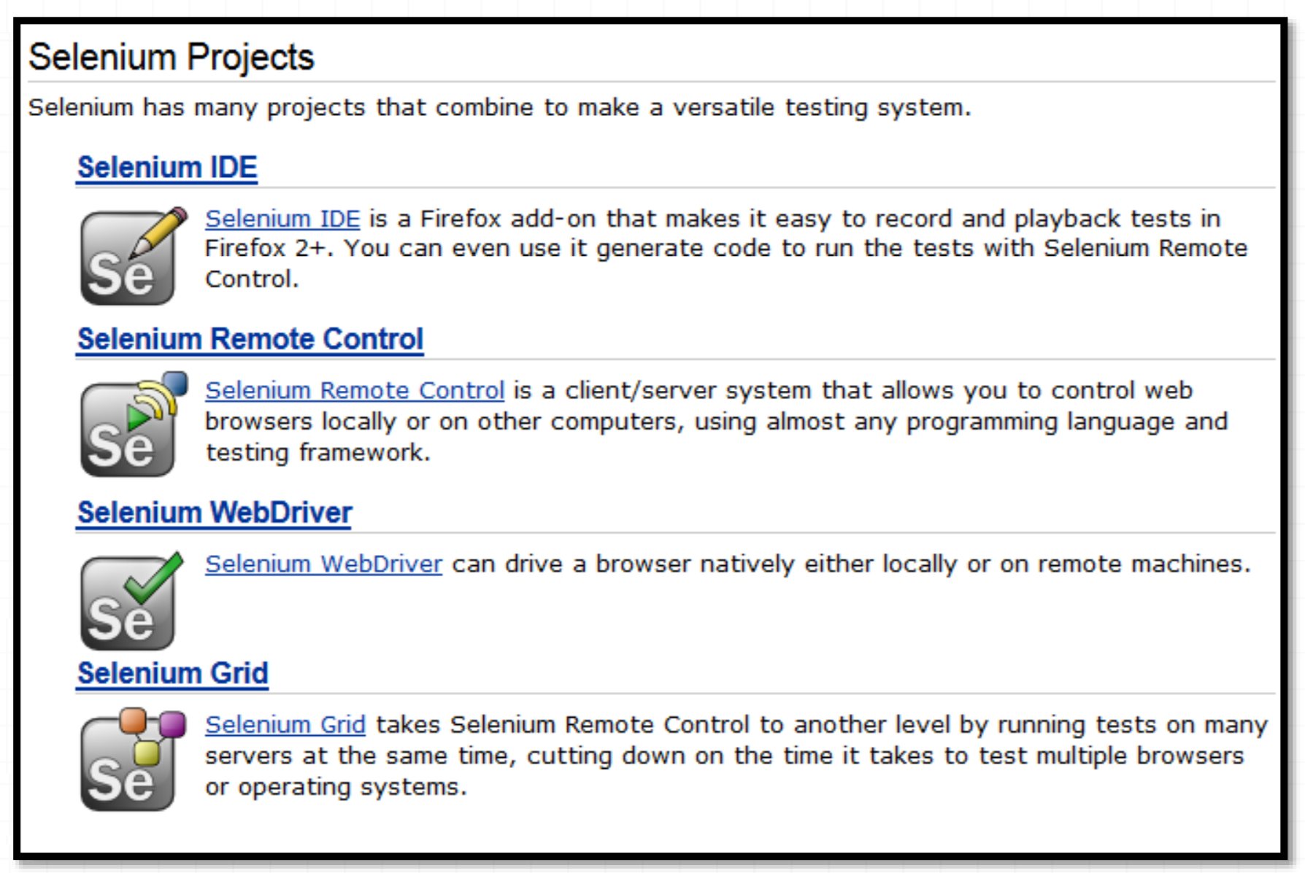
Selenium world

Slide 9
Selenium Tools
Selenium IDE
Rapid prototyping tool for building test scripts
Firefox plugin
Can be used by developers with little to no programming experience to write simple tests quickly and gain familiarity with the Selenese commands
Has a recording feature that records a user’s live actions that can be exported in one of many programming languages
Does not provide iteration or conditional statements for test scripts
Can only run tests against FireFox
Developed tests can be run against other browsers, using a simple command-line interface that invokes the Selenium RC server
Can export WebDriver or Remote Control scripts (these scripts should be in Page Object structure)
Allows you the option to select a language for saving and displaying test cases

Slide 10
Selenium Tools
Selenium RC aka Selenium 1
It ‘inject’ JavaScript functions into the browser when the browser is loaded and then uses its JavaScript to drive the AUT within the browser
Mainly supported in maintenance mode
Provides support for several programming languages

Slide 11
Selenium Tools
Selenium WebDriver
Designed to provide a simpler, more concise programming interface in addition to addressing some limitations in the Selenium-RC API
Developed to better support dynamic web pages where elements of a page may change without the page itself being reloaded
Makes direct calls to the browser using each browser’s native support for automation.
Has the Selenium 1 (aka Selenium RC) underlying technology for flexibility and Portability
Migrating From Selenium RC to Selenium WebDriver
Not tied to any particular test framework, so it can be used equally well in unit testing or from a plain old “main” method.

Slide 12
Selenium Tools
Selenium Grid
Scales the Selenium RC solution for large test suites and test that must be run in multiple environments
Tests can be run in parallel with simultaneous execution (different tests on different remote machines)
It allows for running your tests in a distributed test execution environment
Used to run your tests against multiple browsers, multiple versions of browser, and browsers running on different operating systems
It reduces the time it takes for the test suite to complete a test pass

Slide 13
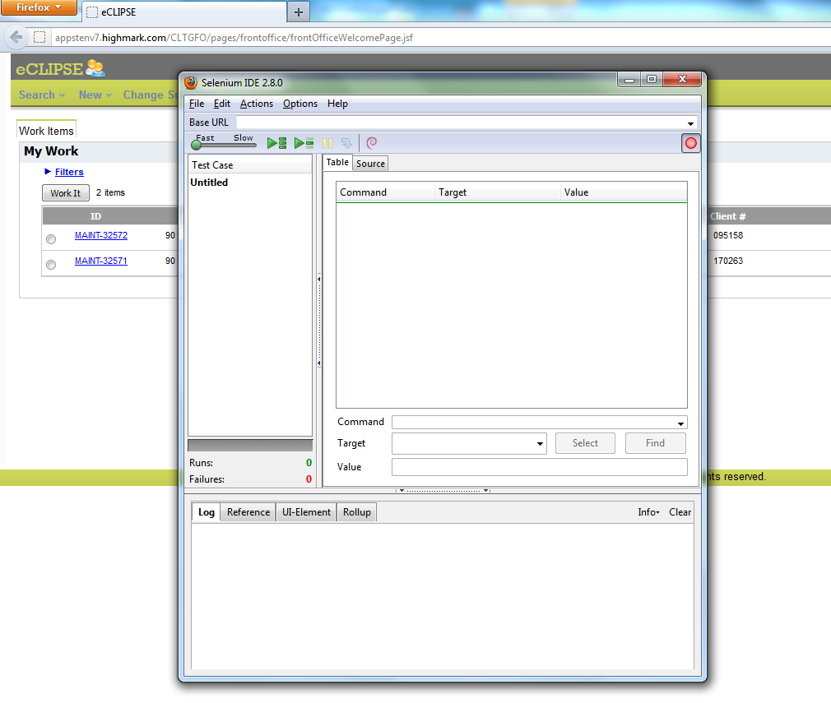
Selenium IDE

Slide 14
Selenium IDE
Selenese Commands
Action
Manipulate the state of the application
Used with “AndWait” (clickAndWait)
Accessors
Examines the application state and stores the results in variables
Used to auto generate Assertions
Assertions
Similar to Accessors but verifies the state of the application to what is expected
Modes: assert, verify and waitFor

Slide 15
Selenium IDE
Syntax
Has two parameters (both are not required)
Can view command requirements from the command reference tab
Parameters
Locators identify a UI Element on a page
Test Patterns are used for asserting or verifying
Selenium variable or Text Patterns that can be entered in input fields or drop down selections

Slide 16
Selenium IDE
Selenese Command (continued)
AndWait
Tells Selenium to wait for the page to load after an action has been performed
Used when triggering navigation/page refresh (test will fail otherwise)
Command: clickAndWait
WaitFor
No set time period
Dynamically waits for the desired condition, checking every second
Commands: waitForElementPresent, waitForVisible, etc…
Echo
Used to display information progress notes that is displayed to the console during test execution
Informational notes can be used to provide context within your test results report
Used to print the contents of Selenium variables

Slide 17
Selenium IDE
Store Commands and Selenium Variables
Selenium variables can be used to store constants at the beginning of scripts and values passed to a test script from the command-line, another program or file
Store Command
Two parameters (text value and Selenium variable)
Uses ${} to access the value of a variable
Can be used in the first or second parameter or within a locator expression
Other Store Commands: storeElementPresent, storeText, storeEval, ect…

Slide 18
Selenium IDE
JavaScript and Selenese Parameters
JavaScript uses script and non-script Selenese parameters
Parameters can be accessed via a JavaScript associative array “storedVars[]”
Script Parameters
Specified by assertEval, verifyEval, storeEval and waitForEval
A snippet of JavaScript code is placed into the appropriate field, normally the Target field (script parameters are usually the first or only parameter)
Non-Script Parameters
Uses JavaScript to generate values for elements with non-script parameters
JavaScript must be enclosed in curly braces and proceeded by the label “javascript”

Slide 19
Selenium IDE
Commonly Used Selenium Commands
open
click/clickAndWait
verifyTitle/assertTitle
verifyTextPresent
verifyElementPresent
verifyText
verifyTable
waitForPageToLoad
waitForElementPresent

Slide 20
Selenium IDE
Locators
By Identifier
Used by default
Locator type is “identifier”
First element with id attribute value matching the location will be used
First element with a name attribute matching the location will be used if there are no id matches
By ID
More limited than the “identifier” type
Locator type is “id”
Use this type when you know the element’s id
By Name
Locates an element with a matching name attribute
Filters can be applied for elements with the same name attribute
Locator type is “name”

Slide 21
Selenium IDE
X-Path
Used for locating nodes in an XML document
Elements can be located in regard to absolute terms or a relative position to an element that has a specified id or name attribute
Can locate elements via attributes other than id or name
Starts with “//”
By DOM
Can be accessed using Javascript
Locator type is “document”
By CSS
Uses the style binding of selectors to elements in a document as a locating strategy
Faster than X-Path and can find the most complicated objects in an intrinsic HTML document
Locator type is “css”

Slide 22
Selenium IDE
Matching Patterns
Text Patterns
A parameter required by following Selenese commands: verifyText, verifyText, verifyTitle, verifyAlert, assertConfirmation, verifyPrompt, ect…
Globbing Patterns
Pattern matching based on wild card characters (*, [], -)
Uses the “glob:” label
Default pattern matching scheme
Regular Expressions
The most powerful pattern matching scheme
Prefixed with “regexp:” label
Exact Patterns
Uses no special characters, no need to escape characters
Prefixed with “exact:” label

Slide 23
Selenium IDE
Alerts, Pop-ups and Multiple Windows
In Selenium, JavaScript alert and confirmation pop-ups will not appear, they are overridden at runtime by Selenium’s own JavaScript
Alert pop-ups, however, still have a presence and would need to be asserted with one of the various assertFoo functions (assertFoo(pattern), assertFooPresent(), assertFooNotPresent(), storeFoo(variable), storeFooPresent(variable), ect…
Confirmation pop-ups select “Ok” by default and use assertConfirmation, assertConfirmationPresent, ect.. functions

Slide 24
Selenium IDE
Debugging and Start Points
Set a debug start point by right-clicking a command and toggle “break point/start point”
The Find button highlights the currently selected UI element on the displayed page. From the Table view, select any command that has a locator parameter and click the Find button
To view portions of the Page Source, select the respective portion of the web page, right-click, select view selection source
In recording a locator-type argument, Selenium IDE stores additional information that presents the user with alternative locator-type arguments

Slide 25
Selenium IDE
User Extensions
JavaScript files created for customizations and features to add additional functionality to Selenium IDE
For Flow Control, install the goto_sel_ide.js extension

Slide 26
Selenium IDE
Java Test Script Example
public void testGoogleTestSearch() throws Exception
{
selenium.open("http://www.google.com/webhp");
assertEquals("Google", selenium.getTitle());
selenium.type("q", "Selenium OpenQA");
selenium.click("btnG");
selenium.waitForPageToLoad("5000");
assertEquals("Selenium OpenQA - Google Search",
selenium.getTitle());
}

Slide 27
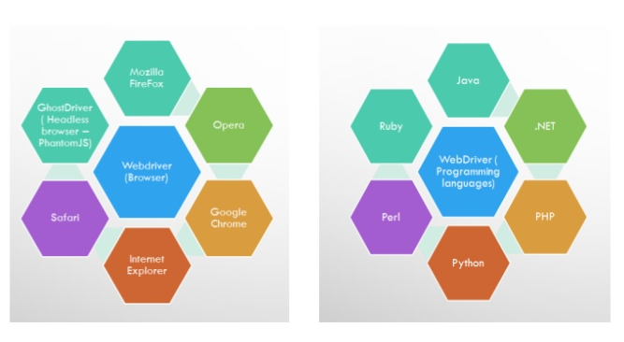
WHY Selenium WebDriver?

Slide 28
Selenium WebDriver
Project Setup
Java
The easiest way is use Maven. Maven will download the java bindings (the Selenium 2.0 java client library) and all its dependencies, and will create the project for you, using a maven pom.xml (project configuration) file
You can then import the maven project into your preferred IDE, IntelliJ IDEA or Eclipse.
From a command-line, CD into the project directory and run maven as follows: mvn clean install

Slide 29
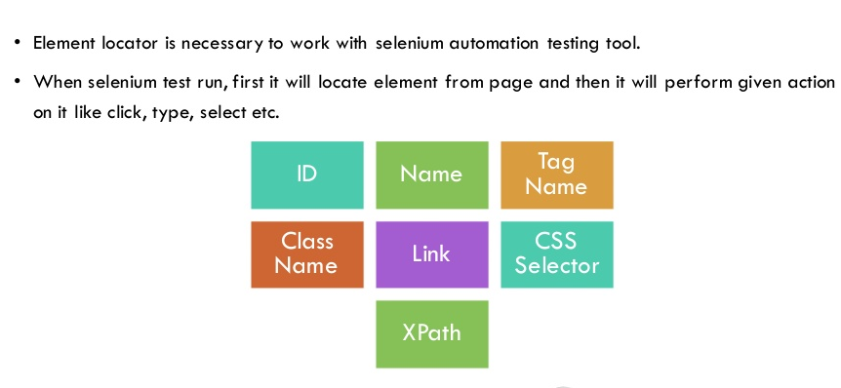
ELEMENT LOCATORS IN WebDriver

Slide 30
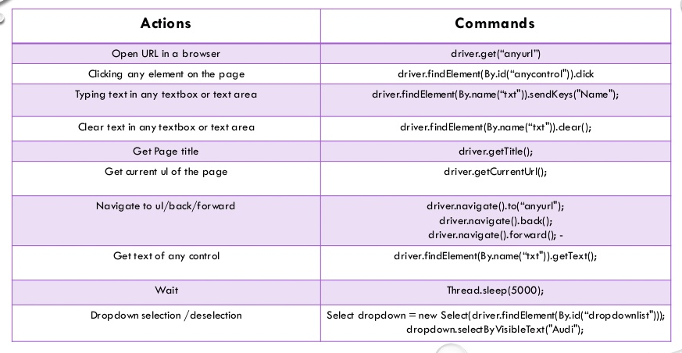
BASIC ACTION COMMANDS

Slide 31
Selenium WebDriver
Commands and Operations
To fetch a page you would use the “get” command
driver.get("http://www.google.com");
Locating UI Elements
Language bindings expose a “findElement” and “Find Elements” method
The “Find” methods take a locator or query object called “By”
WebElement element= driver.findElement(By.id("coolestWidgetEvah"));
List<WebElement>cheeses = driver.findElements(By.className("cheese"));
WebElement frame = driver.findElement(By.tagName("iframe"));
WebElement cheese = driver.findElement(By.name("cheese"));
WebElement cheese = driver.findElement(By.linkText("cheese"));
WebElement cheese = driver.findElement(By.partialLinkText("cheese"));
Web Element cheese = driver.findElement(By.cssSelector(“#food.span.dairy.aged”)) List<WebElement> inputs = driver.findElements(By.xpath("//input"));
WebElement element = (WebElement) ((JavascriptExecutor)driver).executeScript("return $('.cheese')[0]");

Slide 32
Selenium WebDriver
Input and Navigation
Select select = new Select(driver.findElement(By.tagName("select"))); select.deselectAll(); select.selectByVisibleText("Edam");
driver.findElement(By.id("submit")).click();
driver.switchTo().window("windowName");
for (String handle : driver.getWindowHandles()) { driver.switchTo().window(handle); }
driver.switchTo().frame("frameName");
Alert alert = driver.switchTo().alert();
driver.navigate().to("http://www.example.com");
driver.navigate().forward(); driver.navigate().back();

Slide 33
Selenium WebDriver
Page Objects
OO Library that separates test code into an MVC pattern bringing OOP to test scripts
Language neutral pattern for representing a complete page or position of a page in an OO manner
Requires Language specific coding
Used for maintenance, script cascading, enhanced script readability/functionality

Slide 34
Selenium WebDriver
Scripts and Page Objects
Scripts are more procedural while Page Objects are detail oriented
Locators appear once in all Page Objects of a page and do not cross Page Object boundaries
Uses Elements, Actions and Synchronization
Order of Operation
Locator
Element Implementation
Add Elements to Page Objects
Actions

Slide 35
Selenium WebDriver
Do not create the Page Object all at once, build test incrementally
Scripts Should
Not contain any synchronization code
Not contain any Driver API calls (promotes changes to Selenium or other technology without changing the scripts)
Has asserts (determination of results)

Slide 36
Selenium WebDriver
Driver Implementations
HtmlUnitDriver
The fastest and most lightweight implementation of WebDriver
HtmlUnit is a java based implementation of a WebBrowser without a GUI
For any language binding (other than java) the Selenium Server is required to use this driver
A pure Java solution and so it is platform independent
Supports JavaScript but emulates other browsers’ JavaScript behaviour
FireFox Driver
Controls the Firefox browser using a Firefox plugin
Runs in a real browser and supports JavaScript
Faster than the Internet Explorer Driver but slower than HtmlUnitDriver

Slide 37
Selenium WebDriver
Internet Explorer Driver
This driver is controlled by a .dll files and is thus only available on Windows OS
Each Selenium release has its core functionality tested against versions 6, 7 and 8 on XP, and 9 on Windows7
Runs in a real browser and supports JavaScript
XPath is not natively supported in most versions
CSS is not natively supported in versions 6 and 7
CSS selectors in IE 8 and 9 are native, but those browsers don’t fully support CSS3

Slide 38
Selenium WebDriver
Driver Implementation
Chrome Driver
Chrome Driver is maintained / supported by the Chromium Project
WebDriver works with Chrome through the chromedriver binary (found on the chromium project’s download page)
Runs in a real browser and supports JavaScript
Because Chrome is a Webkit-based browser, the Chrome Driver may allow you to verify that your site works in Safari. Note that since Chrome uses its own V8 JavaScript engine rather than Safari’s Nitro engine, JavaScript execution may differ
Slower than the Html Unit Driver

Slide 39
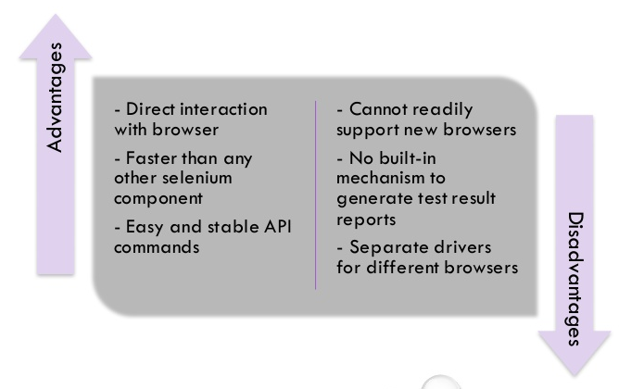
ADVANTAGES & DISADVANTAGES OF WEBDRIVER

Slide 40
Selenium WebDriver
Opera Driver
See the Opera Driver wiki article in the Selenium Wiki for information on using the Opera Driver
iOS Driver
See either the ios-driver or appium projects
Android Driver
See the Selendroid project

Slide 41
Selenium WebDriver
Example Java Implementation
LoginPage.java
HomePage.java
LoginTest.java

Slide 42
Selenium RC
In Selenium RC, the Selenium Server launches and kills browsers, interprets and runs the Selenese commands passed from the test program, and acts as an HTTP proxy, intercepting and verifying HTTP messages passed between the browser and the AUT
Client libraries which provide the interface between each programming language and the Selenium RC Server.
The primary task for using Selenium RC is to convert your Selenese into a programming language

Slide 43
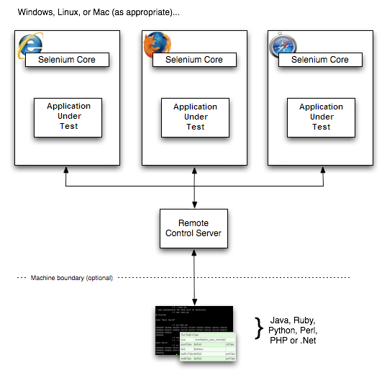
Selenium RC

Slide 44
Selenium RC
Sample Test Script
open | /
type | q | selenium rc
clickAndWait | btnG
assertTextPresent | Results * for selenium rc

Slide 45
Selenium RC
/** Add JUnit framework to your classpath if not already there
* for this example to work
*/
package com.example.tests;
import com.thoughtworks.selenium.*;
import java.util.regex.Pattern;
public class NewTest extends SeleneseTestCase {
public void setUp() throws Exception {
setUp("http://www.google.com/", "*firefox");
}
public void testNew() throws Exception {
selenium.open("/");
selenium.type("q", "selenium rc");
selenium.click("btnG");
selenium.waitForPageToLoad("30000");
assertTrue(selenium.isTextPresent("Results * for selenium rc"));
}}

Slide 46
Selenium RC
Learning the API
setUp("http://www.google.com/", "*firefox");
The Browser is manipulated by a Browser Instance that is assigned to a program variable
This program variable is then used to call methods from the browser
Selenese commands are then ran by calling the respective methods from the browser variable - selenium.type(“field-id”,”string to type”)
To utilize iteration and conditional logic, Selenium RC uses program language specific methods in conjunction with Selenese commands
Use the getEval method of selenium API to execute JavaScript from selenium RC

Slide 47
Selenium RC
Server, Security and Browers Configurations
Command line options can be used to change the default server behaviour.
If your AUT is behind an HTTP proxy which requires authentication then you should configure http.proxyHost, http.proxyPort, http.proxyUser and http.proxyPassword
You can run Selenese html files directly within the Selenium Server by passing the html file to the server’s command line
When launching selenium server the -log option can be used to record valuable debugging information reported by the Selenium Server to a text file
When dealing with HTTPS in a Selenium RC test, there is a run mode that supports handling security pop-ups and processes the security certificate for you
When a browser is not directly supported, you may still run your Selenium tests against a browser of your choice by using the “*custom” run-mode (i.e. in place of *firefox or *iexplore) when your test application starts the browser.

Slide 48
Selenium Grid
A Grid consists of a single Hub, and one or more Nodes. Both are started using a selenium-server.jar executable.
The Hub receives a test to be executed along with information on which browser and ‘platform’ (i.e. WINDOWS, LINUX, etc) where the test should be run.
Since the Hub knows the configuration for each registered Node, it selects an available Node that has the requested browser-platform combination
Selenium commands initiated by the test are sent to the Hub, which passes them to the Node assigned to that test
The Node runs the browser, and executes the Selenium commands within that browser against the application under test

Slide 49
This is all I have for today! Thank you for joining the session!

